Slide 1



University of Technology and Education FACULTY FOR HIGH QUALITY TRAINING
ELECTRONIC COMMERCE
CHAPTER 01
Introduction Electronic Commerce
Lecturer: Nguyen Thien Bao

Slide 2
TABLE OF CONTENTS
What is E-Commerce?
E-Commerce’s history and current trends.
Which types of it.
1
2
3

Slide 3
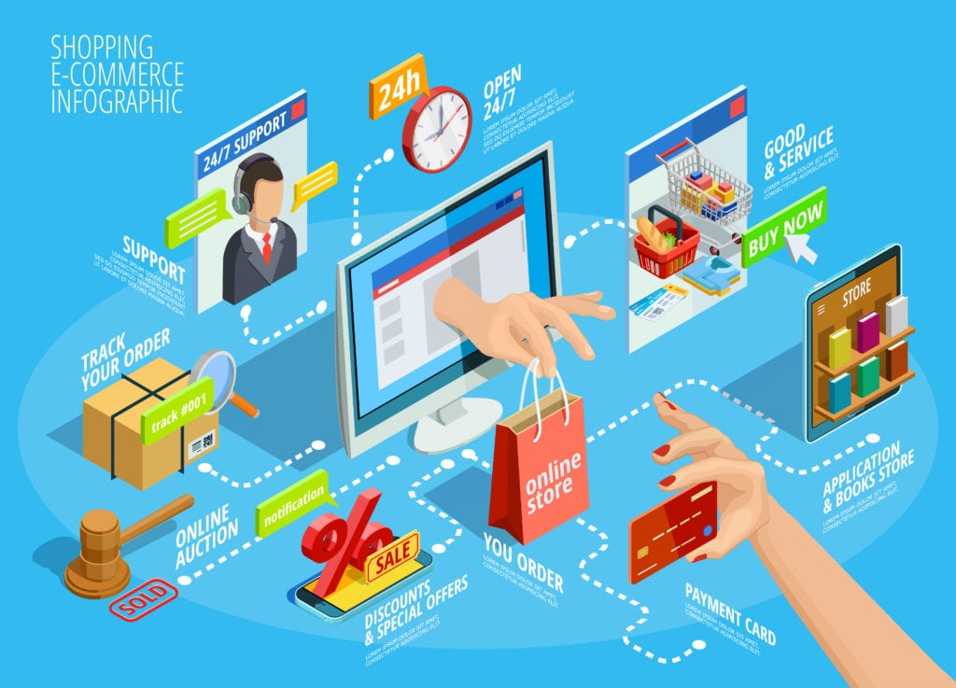
WHAT IS ELECTRIC COMMERCE

Slide 4
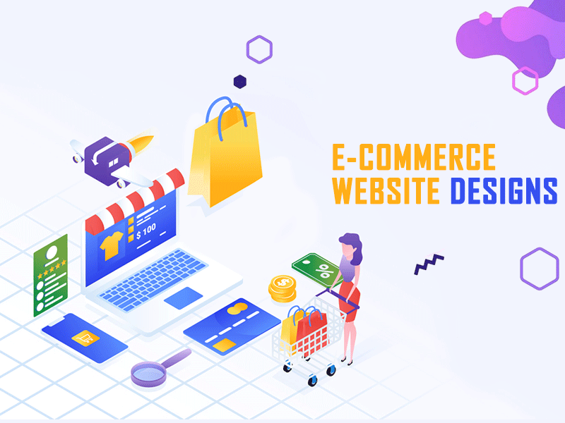
Commerce is nothing but buying and selling of goods. It has been around for many years starting form barter system where there was just exchange of goods to using precious metals to using coin and then paper money and plastic money.
E-Commerce or Electronic Commerce means buying and selling of goods, products, or services over the internet. ... The standard definition of E-commerce is a commercial transaction which is happened over the internet
- The sales, exchanging happen online
- Potentially sell across the world
- Limit in personal interaction
- Delivery of goods and services might take some time
- It is available 24/7 and can be done day or night
- Traditional commerce used to happen face to face
- Limit in particular geographical location
- Personal interaction and delivery of goods was instantaneous.
- Limit in certain business hours typically during day time.

Slide 5
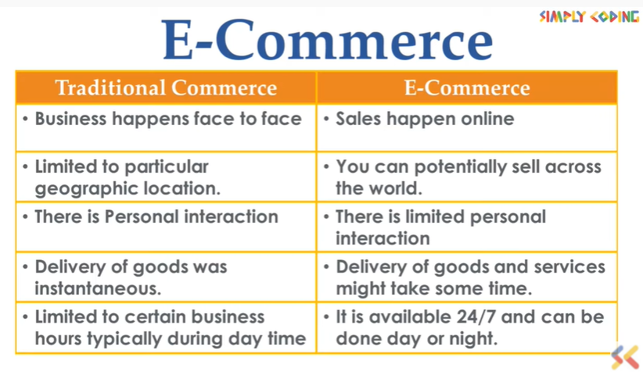
E-Commerce versus Traditional Commerce

Slide 6

HISTORY & CURRENT TRENDS
Presented by Jaden

Slide 7
TABLE OF CONTENTS
2.1
2.2
2.3
EARLY CHANGES
THE GROWTH
TRENDS OF E-COMMERCE

Slide 8

2.1
ENORMOUS CHANGES OF TECHNOLOGY

Slide 9
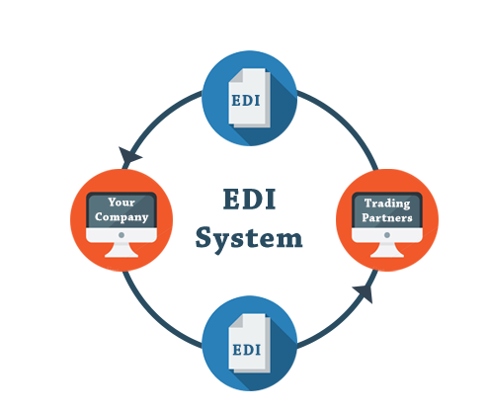
In 1960, the introduction EDI-Electronic Data Interchange paved the way for the modern-day ecommerce.

Slide 10
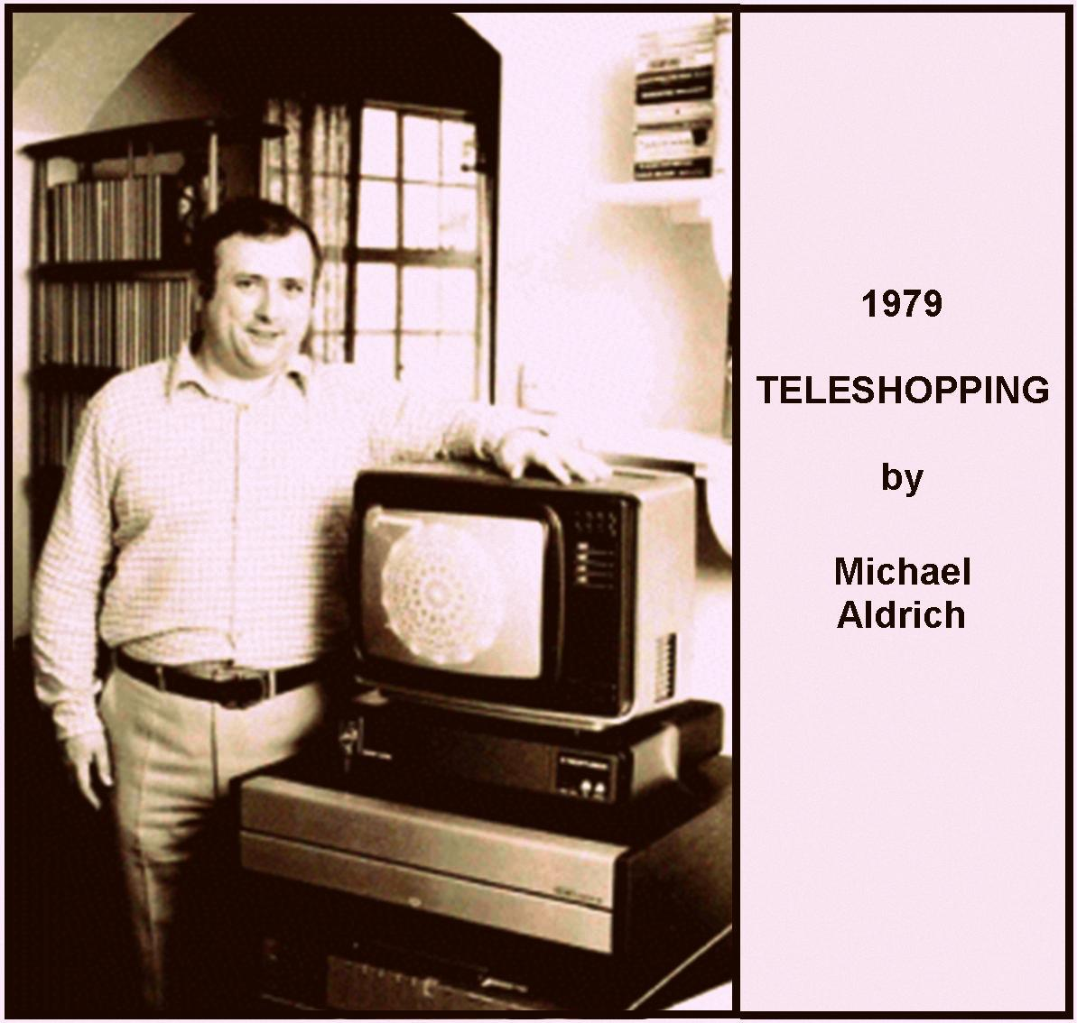
In 1979, Michael Aldrich connected a domestic tv by telephone line to a real-time transaction processing computer and invented what he called teleshopping. Today it’s called online shopping and e-commerce and e-business

Slide 11
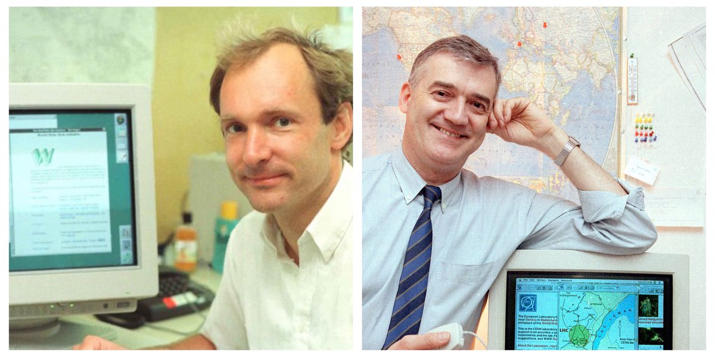
In 1990, Tim Berners Lee and Robert Cailliau invented WorldWideWeb. Lee used a computer to created the first web browser.

Slide 12





1990-2000
Google Shopping
1995
1995
1998
1995
1998
Yahoo!

Slide 13

2.2
THE GROWTH OF E-COMMERCE

Slide 14

KEY STAGES
1995-2000
Dot-com bubbles
2006-now
Evolution
1995
The start
2001-2006
Consolidation

Slide 15

2.3 TRENDS

Slide 16
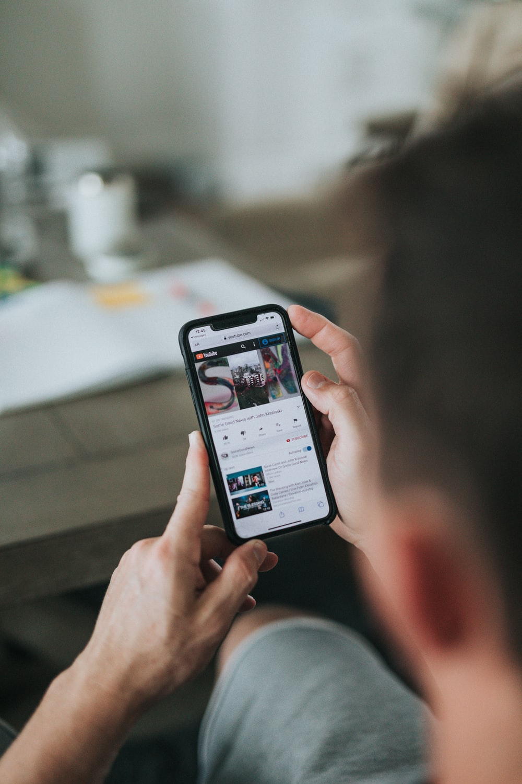
1/ USING VIDEO MARKETING
340%
Average visitor time increase while bounce rate drops on sites with product’s commercial
73%
4 TIMES
Of users are more likely to buy a product
People are 4 times more likely to watch a video than reading a description

Slide 17
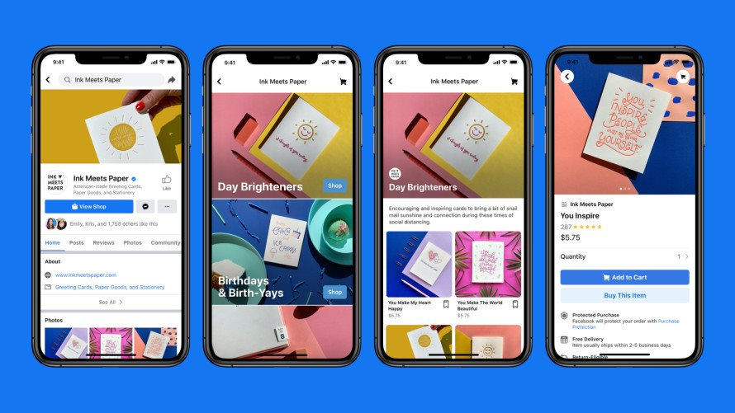
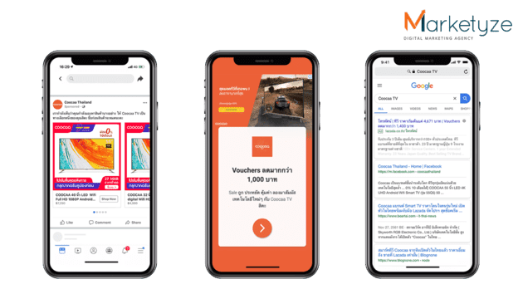
2/
USING SOCIAL MEDIA

Slide 18
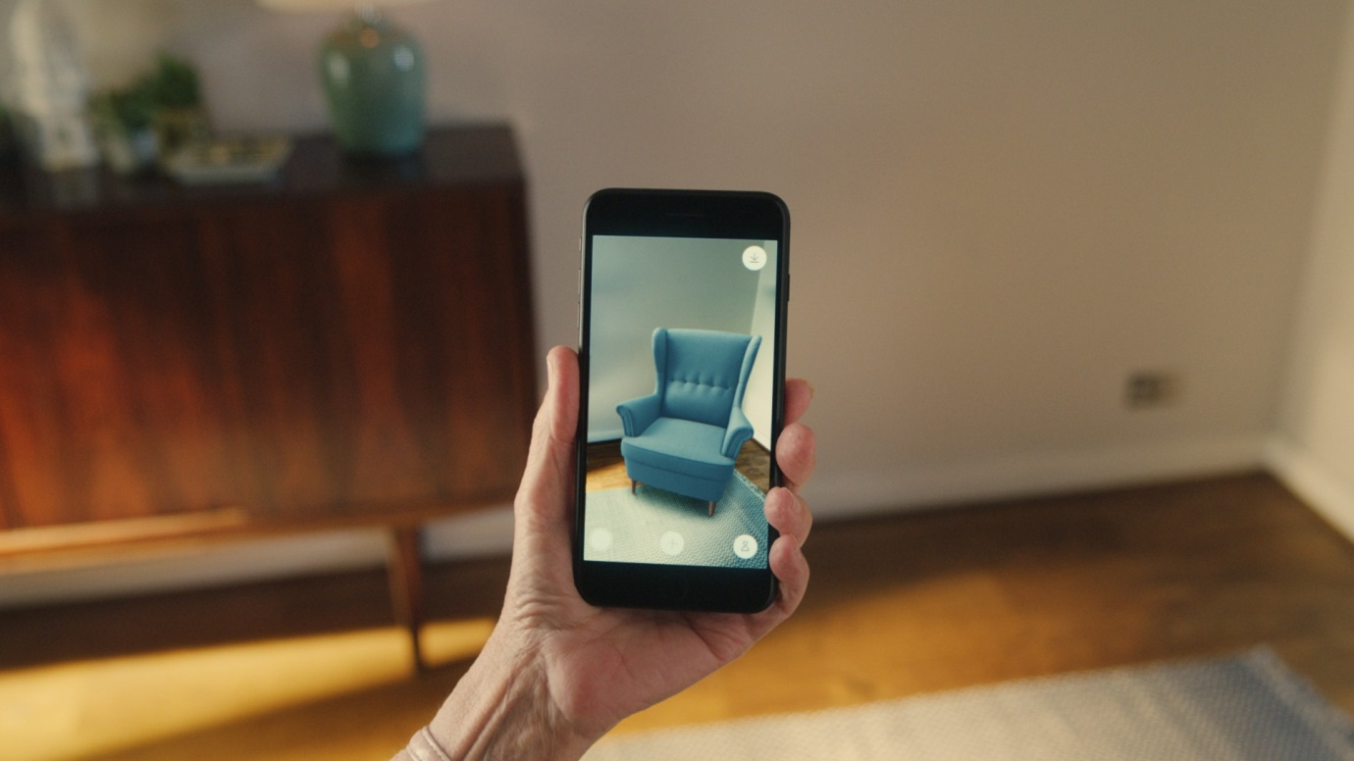
3/
USING AR (Augmented Realty)
Using AR allows customers to preview products or experience services in their own time before electing to make a purchase.

Slide 19

Types of E-Commerce
Presented by Jason

Slide 20
Types of E-Commerce
Form Of Service
Level Of Using Information
Network Technology
Enrollment

Slide 21
Enrollment
01
02
03
Business to Business
Business to Consumer
Consumer to Consumer
04
05
Consumer to Business
E-Government
B2B
B2C
C2C
C2B
G2C, G2B, G2G

Slide 22
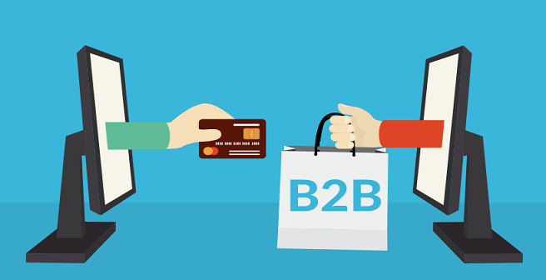
01
Business to Business

Slide 23
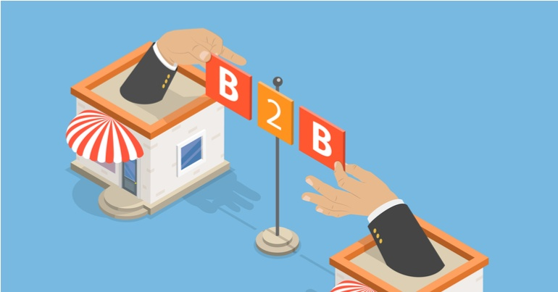
B2B
This is Business to Business transactions. Here the companies are doing business with each other. The online transactions only involve the manufacturers, wholesalers, retailers etc.

Slide 24
B2B
Directories and product and supply exchange websites that allow businesses to search for products, services and information and to initiate transactions through e-procurement interfaces.

Slide 25
B2B
A cybersecurity company is providing online security software aimed at minimizing credit card fraud for an e-commerce company.

Slide 26


Slide 27
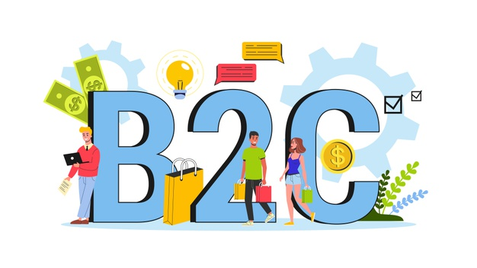
02
Business to Cusumer

Slide 28
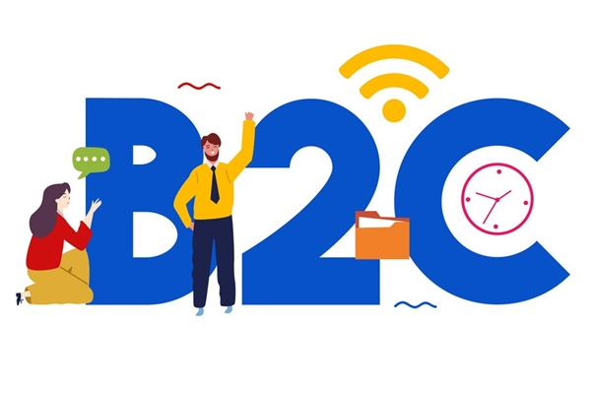
B2C
The company will sell their goods and/or services directly to the consumer. The consumer can browse their websites and look at products, pictures, read reviews. Then they place their order and the company ships the goods directly to them.

Slide 29

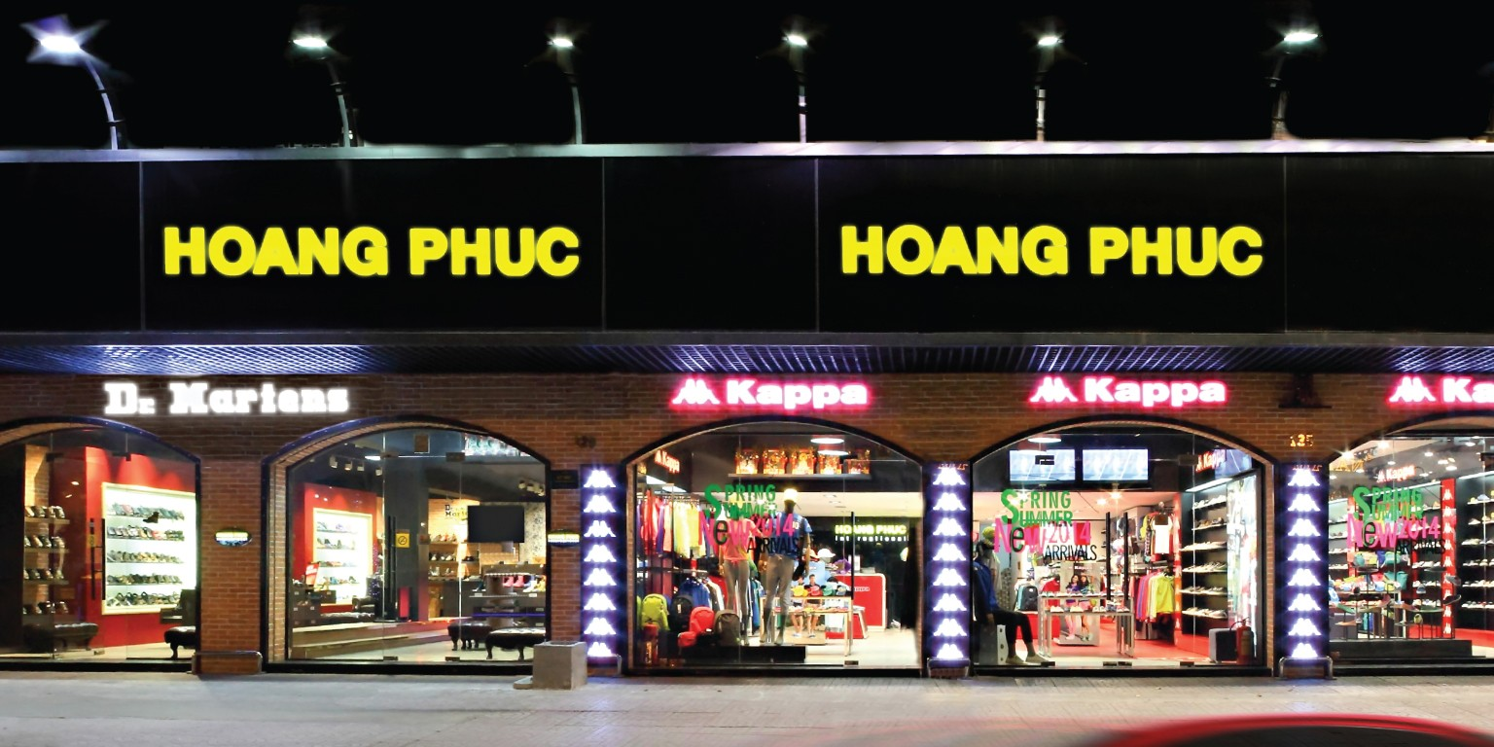



Slide 30
DIFFERENCES
 | B2B | B2C
Consumer | Business ==> Business | Business ==> Individual
Transaction | Contract, Negotiation | Terms already exist
Sales Process | New, Phone | Coupon, Voucher

Slide 31
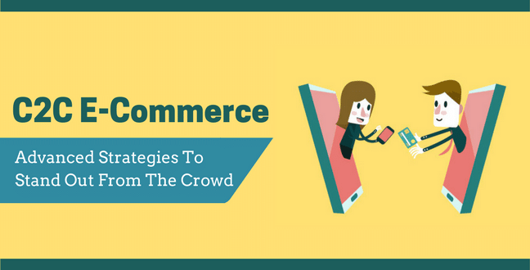
03
Consumer to Consumer

Slide 32
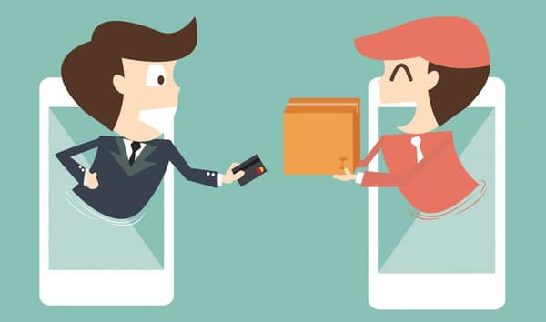
C2C
Consumer to consumer, where the consumers are in direct contact with each other. No company is involved. It helps people sell their personal goods and assets directly to an interested party.

Slide 33
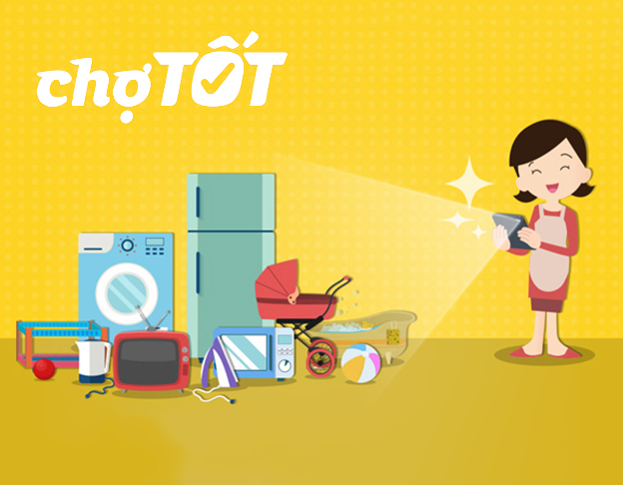


Slide 34
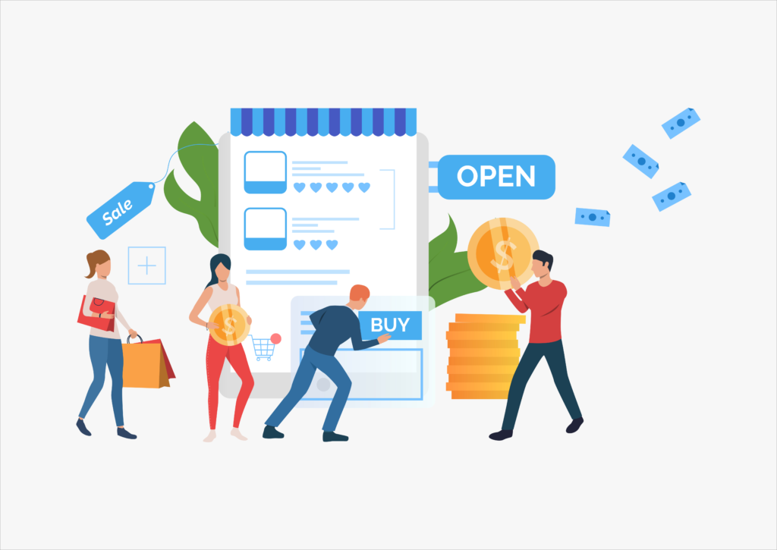
04
Consumer to Business

Slide 35
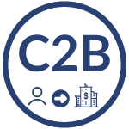
C2B
Consumer-to-business (C2B) is a type of e-commerce in which consumers make their products and services available online for companies to bid on and purchase. This is the opposite of the traditional commerce model of B2C.

Slide 36

For example an IT freelancer who demos and sells his software to a company.
E.g: Fiver, Upwork, Shutterstock,…

Slide 37
DIFFERENCES
 | C2C | C2B
Consumer | Individual ==> Individual | Individual ==> Business
Transaction | Deal | Deal, By request
Sales Process | Auction, Exchange | Buy and sell

Slide 38
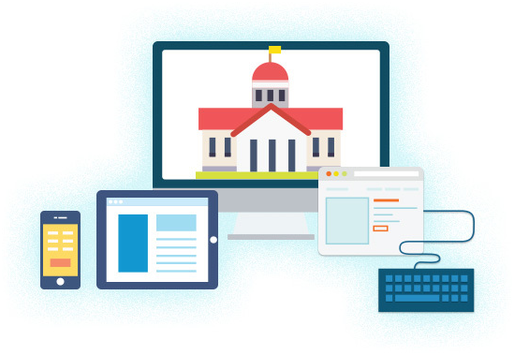
Government E-Commerce
05

Slide 39
E-Government
E-commerce model in which the government will use electronic means (mainly computers and internet) to communicate with businesses, citizens and government organizations, as well as providing public services.
The types of E-Government: B2G, C2G, E.g: Synergetics Inc, websites for individuals pay tax or tuition fee,…
The benefit of e-government implementation is increased transparency, reduce corruption, reduce costs for participants to participate, as well as to help joint quick and easy access to businesses and individuals with public services.

Slide 40


